Slide 1
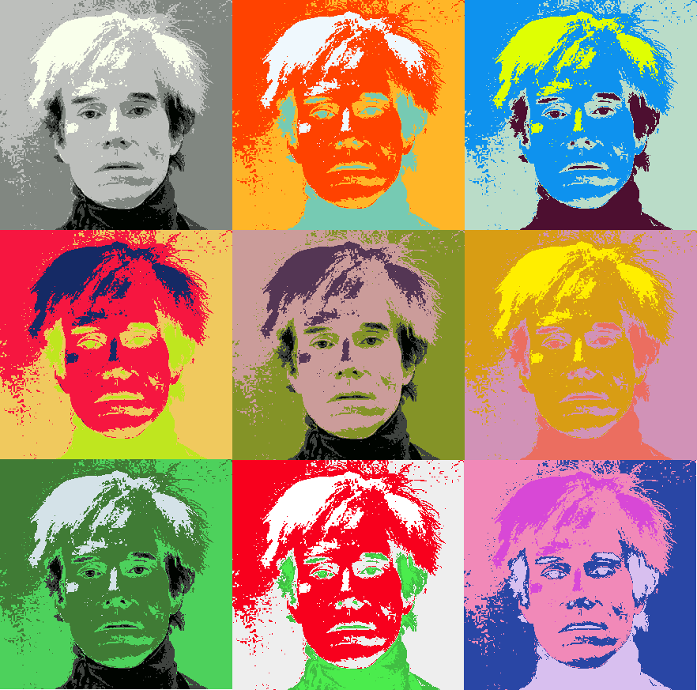
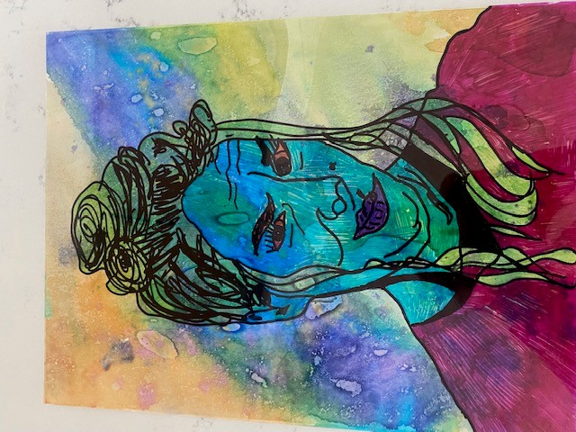
Andy Warhol Self Portraits

Slide 2
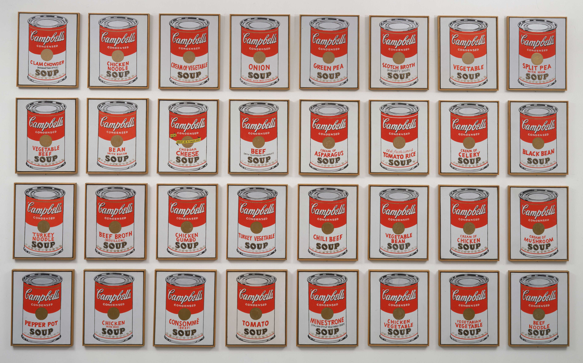
Andy Warhol and POP ART
Warhol described Pop Art in his own words as “Once you ‘got’ pop, you could never see a sign the same way again. And once you thought pop, you could never see America the same way again.”
Warhol debuted the concept of Pop Art in 1961, as he devoted his painting to focusing on mass-produced commercial goods.

Slide 3
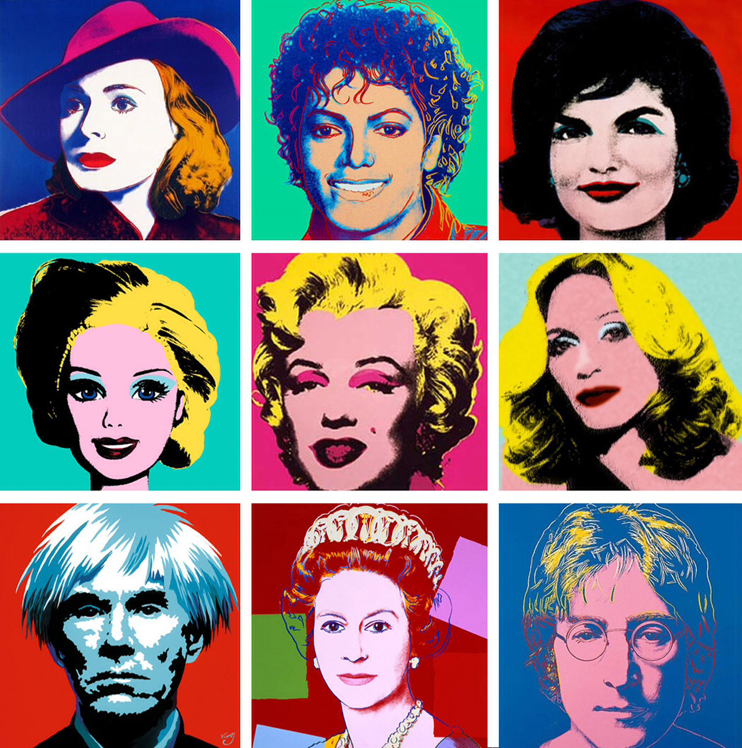
Color and Portraits
Warhol was famous for painting portraits of celebrities and figures in vivid, immensely bright or showy colors. Subjects include Marylin Monroe, Elizabeth Taylor, Mick Jagger, Michael Jackson, the Queen and many more, including himself.

Slide 4
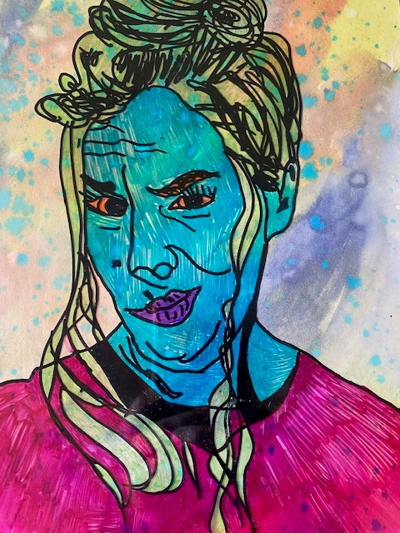
Create your Warhol inspired Self Portrait
Supplies needed
*Up close photocopy of yourself
(black & white edited to show dramatic contrast)
*clear transparency sheet
*black sharpie
*color sharpies
*watercolor paper
(same size as transparency)
*watercolor paint, water, brushes
*course salt

Slide 5
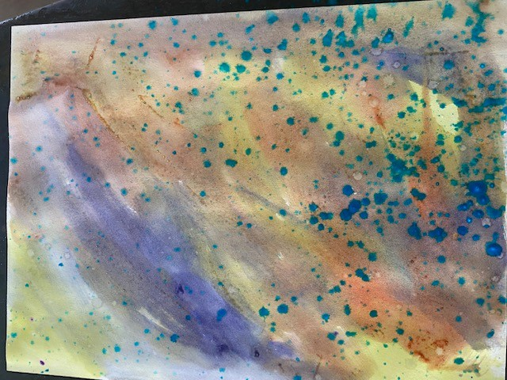
Step 1 Background
Using your watercolor paint cover the entire sheet of watercolor paper. Use several colors or stick with 1 color in varying light and darkness. Add drips, blotches, splatters or streaks and even course salt to play with different watercolor effects. ** aside for later and to dry.**

Slide 6
Step 2 Outline your photocopy
Place your clear transparency sheet over your picture. Using your BLACK sharpie trace a very simple outline of your face, hair, shoulders. You should not be filling in any areas. Just a simple sketch of major shapes and lines. Your eyes, nostrils, ears.
TIPS for Hair. Draw the basic outline and shape of the hail but don’t color in. If you have long hail maybe add just a few long lines inside the hair to show strands. For curly hair add a few wavy lines or loopy loops. For short hair add just a few lines to show direction of hair or thick line to show your part.
Don’t worry, you can add more black later on if you decide its needed.
If your transparency moves don’t panic. Just reposition it and keep going.

Slide 7
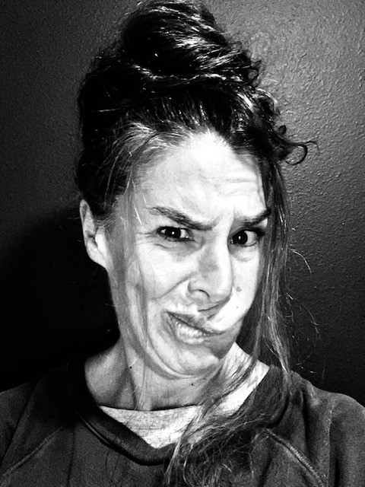
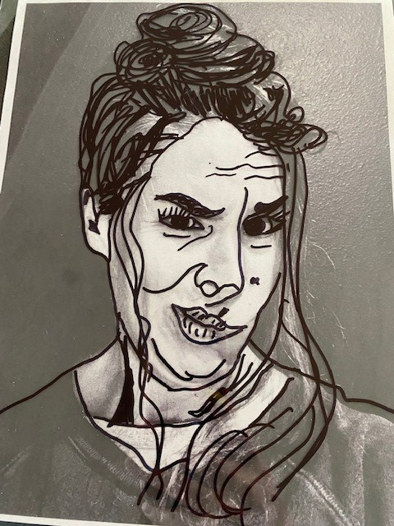

Slide 8
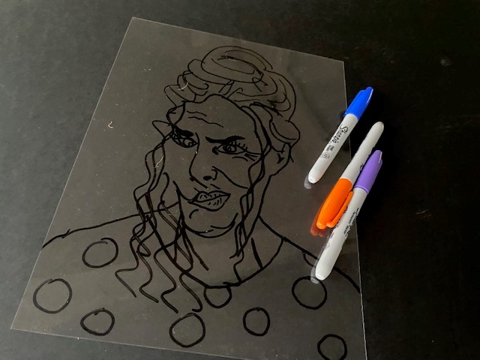
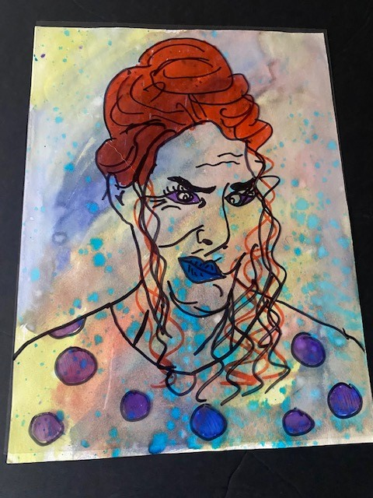
Step 3 Add Color
Choose 2-4 sharpie colors to fill in the empty space in your sketch. Flip transparency over and add color to opposite side of black sharpie. Choose colors that contrast with your background. Add a much or little color as you like. You can also go back and add lines or details with black as needed for desired look.

